Slide 1
Meaning of demand and supply
Unit outline:
Meaning of demand and supply
Law of demand and supply
Individual and market demand and supply (with schedule and graph/curve);
Movement along and shift of a demand and supply curves
Market equilibrium: the interplay of demand and supply
Change in market equilibrium due to factors shifting the demand and supply curves
Price, income and cross-price elasticity's of demand and their measurement by percentage and arc/mid-point methods
Price elasticity of supply
Concept of consumer and producer surpluses
Government intervention in the market through price floor
Price ceiling and tax and effect.

Slide 2
Theory of Demand
Meaning of Demand and Desire
In ordinary speech, the word demand refers to desire. Desire is mere a wish to have something or to enjoy a service. But demand implies more than mere desire. It means that the person is willing and able to pay for the object he desires. For example, if a poor man has desire to purchase and ride a luxurious car. It is mere his desire because he has no ability to pay. Similarly, if a rich man has desire of the same thing but if he is a miser his desire will not convert into demand. Thus, in economics demand refers to effective demand. Effective demand for a thing depends on (i) desire (ii) ability to pay and (iii) willingness to pay. Desire is only one element of demand. Unless desire is backed by ability to pay and willingness to pay, it does not constitute demand.

Slide 3
Theory of Demand
What is demand?
Desire/wants
Effective desires/wants-demand
Desire backed by ability to pay and willingness to pay.
A person(poor): desire to ride a car
A person(rich): desire to ride a car but not readiness to pay
Demand always express in terms of certain price and condition.

Slide 4
Theory of Demand
Meaning of Demand and Desire
Prof. Bober defines demand as “various quantities of a given commodity or service which consumers would buy in one market in a given period of time at various prices, or at various incomes or at various prices of related goods.”
Similarly in the words of Pappas and Brigham “The term demand is defined as the number of units of a particular good or service that consumers are willing to purchase during a specific period and under a given set of conditions.”
Two things are to be noted about quantity demanded. One is that quantity demanded is always expressed at a given price. At different prices different quantities of a commodity are generally demanded. The second thing is that quantity demanded is a flow. It means demand is expressed per period of time for example one thousand Kg. apple per day, seven thousand Kg. per week and so on.

Slide 5
Types of Demand
Price demand:
Qd_{x} = f (P_{x}), ceteris paribus…(2.1) f '< 0.
Keeping other factors constant
Inverse relationship
2. Income demand:
Qd_{x} = f (Yc), ceteris paribus…(2.2) f'> 0, f'<0 & f'=0
Keeping other factors constant
Normal goods: Positive (elastic, inelastic, unitary)
Luxuries: elastic
Inferior (low quality, Giffen): Inverse & no relationship
Neutral goods: salt
3. Cross demand:
Qd_{x} = f (Py), ceteris paribus…(2.2) f'> 0, f'<0 & f'=0
Substitute: if X & Y are perfectly substitute- +ve
Complementary: if X & Y are perfectly complementary -ve

Slide 6
Types of Demand
4. Direct demand and Indirect demand
Demanded for consumption-direct
Demanded to produce other goods- indirect/derived : inputs
5. Composite demand: goods can be used for different purposes- electricity, milk, potato etc.
6. Joint/Tied demand:several things demanded to satisfy single wants: Tea: milk, sugar, tea leaf

Slide 7
Types of Demand
Price demand:
Other things remaining the same, price demand refers to functional relationship between price and quantity demanded of a commodity. It shows negative or inverse relationship between price and quantity demanded of any goods and services under ceteris paribus assumption. Price demand function can be expressed as:
Qd_{x} = f (P_{x}), ceteris paribus …(2.1) f '< 0.
Keeping other factors constant
Where, Qd_{x} is the quantity demand for X commodity (dependent variable), ‘f’ read as ‘function of’ indicates functional relationship and P_{x} is the price of X commodity (independent variable).

Slide 8
Types of Demand
2. Income demand: Other things remaining the same, income demand shows functional relationship between income of the consumer and quantity demanded of a commodity. Income demand may be positive, negative or equal to zero. It is positive in case of normal goods like rice and greater than one in case of superior or luxurious goods like car. Similarly, it is negative for inferior goods like flour while it is equal to zero for neutral goods like salt and matches. Income demand function can be is written as:
Qd_{x} = f (Yc), ceteris paribus …(2.2) f ' > 0 or f '< 0 or f '= 0.
Where, Qd_{x} is the quantity demand for X commodity (dependent variable) ‘f’ read as ‘function of’ indicates functional relationship and Yc is the income of the consumer or household (independent variable).

Slide 9
Types of Demand
3. Cross demand : Other things remaining the same, cross demand shows functional relationship between price of a commodity and quantity demand of another commodity. Like income demand, cross demand may be positive, negative or equal to zero. It is positive if two goods are perfectly substituted to each other like pepsodent and close-up toothpaste. Similarly, it is negative if two goods are perfectly complementary to each other like software and hardware of computer. But it is zero when two goods are not related. In the functional form cross demand can be written as:
Qd_{x} = f (Py),ceteris paribus…(2.3) f ' > 0 or f '< 0 or f '= 0.
Where, Qd_{x} is the quantity demand for X commodity (dependent variable) ‘f’ read as ‘function of’ indicates functional relationship and P_{y} is the price of Y commodity (independent variable).

Slide 10
Types of Demand
4. Direct and indirect demand: If the demand for any goods is for direct consumption, it is known as direct or autonomous or prime demand. The demands for such goods are independent of the demand for other goods. Food, clothes and houses etc., are the examples of direct demand. On the contrary if the goods are demanded for the production of other or subsidiary rather than direct consumption, the demand for such goods is indirect or derived demand. Mostly, the demand for producer goods and industrial goods is the derived demand.
5. Joint demand: If two or more than two goods are demanded at the same time to fulfill the single desire or want of the consumer it is called joint demand. It is based on quantity demand of complements good. In such a case every change in price of one commodity brings about substantial change in quantity demand for complement goods. For example demand for water, milk, sugar and tea to make a cup of tea is known as joint demand. Some time joint demand is also known as tied demand.
6. Composite demand: The demand for any commodity which can be used for several or multiple purposes is known as composite demand. The demands for electricity, coal, milk, potato etc., are some example of composite demand. The demand for such goods increases when their price decreases and vice versa.

Slide 11
Law of Demand
The law of demand is one of the most important laws of economic theory. According to this law other things being equal, if the price of a commodity falls, the quantity demanded of it will rise and if the price of a commodity rises, its quantity demanded will decline. According to Alfred Marshall “The amount demanded increases with a fall in price and diminishes with a rise in price.” Similarly, according to Paul A. Samuelson “Law of demand states that the people will buy more at lower prices and buy less at higher prices, other things remaining the same.” Thus, law of demand shows the inverse relationship between price of a commodity and the quantity demanded under the ceteris paribus assumption. The law of demand i.e., price-quantity relationship can be expressed with the help of demand function as:
Qd_{x} = f (P_{x}), ceteris paribus …(i) f ' < 0.
Where, Qd_{x} is the quantity demand for X commodity (dependent variable) ‘f’ read as ‘function of’ indicates functional relationship and P_{x} is the price of X commodity (independent variable).The demand function shows that when the price of X falls its quantity demanded increases and vice versa, keeping other things remaining the same or ceteris paribus.

Slide 12
Assumption of Law of Demand
Qd_{x} = f (P_{x,} , Po, Yc, t, D, Yd, T, A, Pe, W………)
No change in prices of other related goods such as complement and substitute goods.
No change in income of the consumer
No change in taste, habit and preferences of the consumer.
No change in size and composition of population.
No change in distribution of income in the society.
The state of technology will remain constant.
There is no change in advertisement expenditure.
No change in consumer’s expectation about future price of the commodity.
There is no change in weather and such other factors that influence demand.
If there is any change in these assumptions then the inverse price-demand relationship may not hold true. The constancy of these other factors is an important assumption of the law of demand. The law of demand can be explained with the help of demand schedule and a demand curve.

Slide 13
Individual Demand Schedule
.
Points | Prices (in Rs.) | Quantity Demanded (in Units)
A | 6 | 0
B | 5 | 1
C | 4 | 2
D | 3 | 3
E | 2 | 4
F G | 1 0 | 5 6

Slide 14
Demand Curve
Derivation of individual demand curve

Slide 15
Operation of Law of Demand
Why does demand curve slope downwards? or why does demand increase when the price of the commodity falls? The law of demand shows that other things remaining the same when prices falls the quantity demanded of a commodity rises and vice-versa. This inverse relationship between price and quantity demanded of a commodity is reflected in the negative slope of the demand curve. With exception of a very rare case, the demand curve always slopes downward.

Slide 16
Main Reasons….
1. Increase in number of new consumer
As Px Qdx increase in new consumer.
Substitution effect
As Px it becomes relatively cheaper than other commodities so Qdx 3. Income effect
As Px the real income of the consumer or purchasing power will increase & the consumer can buy the same quantity of the commodity with lesser money so Qdx
4. Law of diminishing marginal utility
Due to this law a consumer purchases or consumes more and more units of a commodity, the marginal utilities derive from successive units decline.
5. Put to less important uses
There are number of commodities such as electricity, milk etc., which can be put for different uses.

Slide 17
Exception to the Law of Demand
Goods having the prestige value or the articles of distinction (Conspicuous consumption)
Giffen goods: inferior low quality goods
Price expectation: Px Px
Ignorance of the consumer
Demonstration effect : Friends & neighbors
Impulsive purchases: without planning

Slide 18
Exception to the Law of Demand
Trade cycles: good and bad
Incase of emergencies
Other miscellaneous situations
The law of demand will also fail if there is any significant change in other factors on which demand of a commodity depends. If there is change in income the household, or in prices of related goods, or in tastes and fashion, etc. the inverse price-quantity relation may not hold good.

Slide 19
Derivation of Individual Demand Curve
Individual demand is the quantity demanded by an individual person at different possible prices at a given point of time.
The graphical representation of the individual demand schedule gives us individual demand curve. The individual demand schedule is a schedule of various quantities of a good demanded by an individual consumer at various prices at any given period of time, while keeping everything else constant.

Slide 20
Individual Demand Schedule
Points | Prices (in Rs.) | Quantity Demanded (in Units)
A | 6 | 0
B | 5 | 1
C | 4 | 2
D | 3 | 3
E | 2 | 4
F G | 1 0 | 5 6

Slide 21
Individual Demand Curve

Slide 22
Demand Curve
Simple Technique
law of demand if Px Qdx
Exception to the law of demand px Qdx

Slide 23
Derivation of Market Demand Curve
In fact in a market there are infinite numbers of consumer who are willing to purchase various quantities of a commodity at any specified period of time and price. The market or aggregate demand for a commodity gives the alternative amount of the commodity demanded per time period, at various alternative prices, by all the individuals in the market.
Thus, Market demand is the quantity demanded by all the persons in the market at different possible prices at a point of time.

Slide 24
Derivation of Market Demand Curve
When demand schedules of all the buyers are add up, we get market demand schedule. Graphic presentation of market demand schedule gives us market demand curve. Geometrically, the market demand curve for a commodity is obtained by the horizontal summation of all the individuals’ demand curves for the commodity.
The market demand curve for a particular commodity shows the relationship between price and total quantity demanded of the commodity by the entire consumers in the market while keeping constant all other things determining the demand.

Slide 25
Derivation of Market Demand curve
It is derived from market demand schedule:
Prices (in Rs.) | Q^{d}x by consumer A (units per week) | Q^{d}x by consumer B (units per week) | Market demand (units per week)
10 | 2 | 1 | 3
8 | 4 | 2 | 6
6 | 6 | 3 | 9
4 | 8 | 4 | 12
2 | 10 | 5 | 15

Slide 26
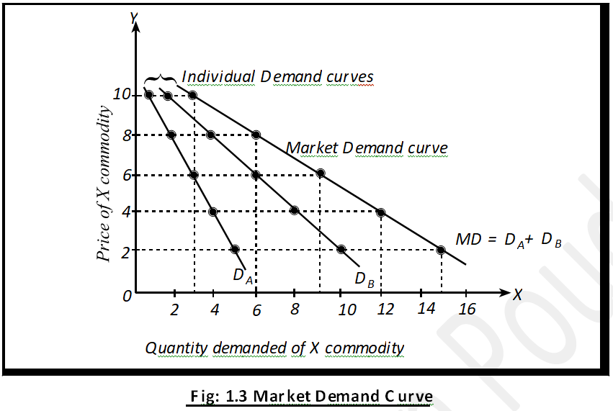
Derivation of Market Demand Curve
MD curve is the horizontal or lateral summation of individual demand curve : MD= D_{A +} D_{B}

Slide 27
Market Demand Curve
Alternative Technique

Slide 28
Movement along a Demand Curve
A movement along a demand curve indicates changes in the quantity demanded of a given commodity because of price changes, other factors remaining constant. When the quantity demanded changes only because of the changes in price, it is the case of expansion or contraction of demand. Expansion in demand means more demand at low price whereas contraction in demand means less demand at high price. Thus, expansion and contraction in demand shows the movement along a same demand curve as shown in Figure:

Slide 29
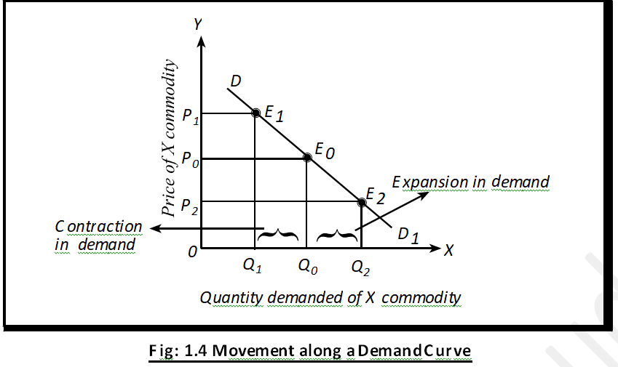
Movement along a Demand Curve
Qdx= f(Px, Po, Yc, t, D, Pe, A, W………)…demand function
Upward movement
Downward movement

Slide 30
Shift in Demand Curve
A shift in the demand curve indicates that there is a change in demand at each possible price because one or more other factors, such as incomes, tastes or the price of some other goods, have changed. This is referred to as a change in demand as opposed to a change in quantity demanded. Change in quantity demanded refers a movement along a given demand curve for a commodity as a result of a change in its price while change in demand refers a shift in the entire demand curve of a commodity resulting from a change in other factors keeping price constant.

Slide 31
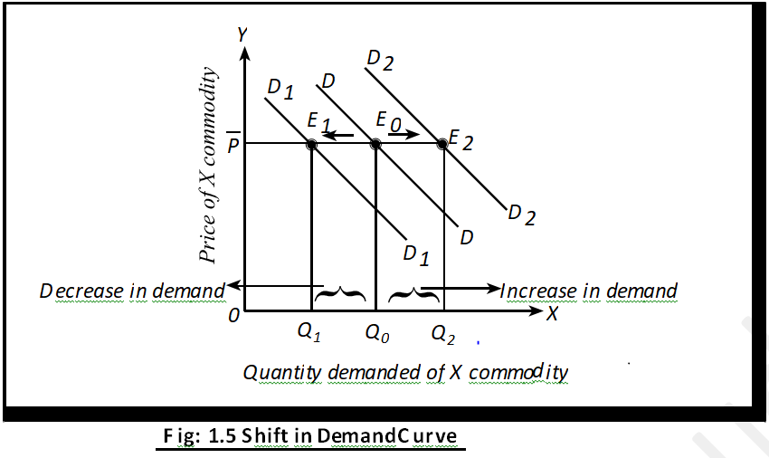
Shift in Demand Curve
Qdx= f(Px, Po, Yc, t, D, Pe, A, W………)…demand function
If Yc Qdx rightward
If Yc Qdx leftward
Y2
Y1
Y0

Slide 32
Causes of Shift in Demand Curve
Q^{d}_{x} = f (P_{x}, P₀, Y_{c}, t, Yd, D, P_{c}, T_{p}, Ds, A, W…) ...(2.5)
Rightward | Leftward
1.Increse in p of substitute 2.Decrease in p of complementary 3. Increase in Yc 4. Some goods is in fashion/taste 5. Increase in D 6. If consumer expect increase in P 7. Increase in A | 1. Decrease in p of substitute 2.Increase in p of complementary 3. Decrease in Yc 4. Some goods is out fashion/taste 5. Decrease in D 6. If consumer expect decrease in P 7. Decrease in A

Slide 33
Factors Causing the Shift in Demand Curve
Demand is a multivariable function. It is not only determined by its own price but also by other factors. Thus, true demand function can be written as:
Qx=f(Px)….. Other things remaining the same
Q^{d}_{x} = f (P_{x}, P₀, Y_{c}, t, Yd, D, P_{c}, T_{p}, Ds, A, W…) ...(2.5)
The factors including price are called determinants of demand. Other factors except price are called factors causing the shift in demand curve.

Slide 34
Factors Causing the Shift in Demand Curve
Changes in prices of the related goods (P_{0 or PS & Pc})
Income of the consumer (Y_{c})
Tastes and preferences of consumers (t)
The size and composition of population (D)
Price expectation (P_{e})
Technical progress (Tp)
Discovery of cheap substitutes (Ds)
Advertisement (A)
Weather (W)
Changes in propensity to consume (P_{c})

Slide 35
Supply
Supply refers to the amount of goods or services that a producer or seller is willing and able to offer in the market at various prices during a specified period of time. Like demand supply is always explained with reference to price and time. There are two important points apply to supply. First the supply refers to what seller offer for sale, not necessarily to what they succeed in selling and second, supply is a flow concept. It means quantity supplied is so much per unit of time, per day, per week, and so on.
Prof. R. G. Lipsey defines supply as “The amount of a commodity that firms will be willing and able to offer for sale is called the quantity supplied of a commodity.” Thus, supply refers to both the willingness and ability to sell goods at a certain price and period of time.

Slide 36
Supply and Stock
Supply and Stock
In the supply market the two terms supply and stock are used frequently in the same sense. But supply should be carefully distinguished from stock. Stock is the total volume of a commodity, which can be brought into the market for sale at a short notice, and supply means the quantity, which is actually brought into the market for sale. In case of other commodities the meaning of stock and supply is different while for perishable commodities like fish and fruits, supply and stock is the same thing because they cannot be store for future sale. In short, stock is potential supply.

Slide 37
Law of Supply
Sx=f(Px)…….f'>0 Supply Function other things remaining the same.
Functional or mathematical relationship between Px & Sx.
As Px Increases QSx also Increases
As Px Decreases QSx also decreases
Law of supply relates to the functional relationship between price of a commodity and its quantity supplied, while keeping all the other factors affecting supply constant. The quantity supplied generally varies directly with price. It means when price of a commodity rises, quantity supplied also rises and when price of a commodity falls, quantity supplied also decreases. Thus, the direction of change in quantity supplied is the same as the direction of change in price. This positive relationship between price and quantity supplied of a given commodity is known as the law of supply. The functional relationship between price of a commodity and its quantity supplied can be expressed with the help of supply function as:
QS_{x} = f (P_{x}), ceteris paribus................(i) f ' > 0.

Slide 38
Assumptions of Law of Supply
Sx= f(Px, PI, T, TS, NF, Of, Pe, W)………..(ii) seller
There is no change in cost of production or prices of inputs. (P_{I})
The state of technology will remain constant. (T)
There is no change in government policy regarding tax and subsidy. (TS)
There is no change in number of firms in the market. (NF)
There is no change in the objective of the firm. (OF)
There is no change in seller’s expectation about future price of the commodity. (Pe)
There is no change in season or weather and such other factors that influence supply. (W)

Slide 39
Supply Schedule
Combination | Prices (in Rs.) | Quantity Supplied(in Units)
A | 2 | 2
B | 4 | 4
C | 6 | 6
D | 8 | 8
E | 10 | 10

Slide 40
Supply Curve
SS curve has positive upward slope

Slide 41
Derivation of Single Producer’s Supply Curve
Single producer’s supply curve is derived from single producer’s supply schedule. The schedule which shows different quantities of a commodity supplied per time period at various alternative prices by an individual firm or producer while keeping all the other factors affecting the supply constant is called single producer’s (or individual) supply schedule. Hence, it shows the relationship between prices of a commodity and its quantity supplied by an individual firm.
The single producer’s supply schedule of commodity X derivation of single producer's supply curve can be explained with the help of schedule and curve as shown in the law of supply.

Slide 42
Derivation of Market Supply Curve
Like single producer’s supply curve market supply curve is derived from the market supply schedule of a commodity. The market supply schedule gives the alternative amounts of the commodity supplied per time period at various alternative prices by all the producers of a commodity in the market while keeping other factors affecting supply constant. When supply schedules of all the producers (or, firms) of commodity are summed up, we get market supply schedule.

Slide 43
Derivation of Market Supply Curve
Like single producer’s supply curve market supply curve is derived from the market supply schedule of a commodity. The market supply schedule gives the alternative amounts of the commodity supplied per time period at various alternative prices by all the producers of a commodity in the market while keeping other factors affecting supply constant. When supply schedules of all the producers (or, firms) of commodity are summed up, we get market supply schedule.

Slide 44
Derivation of Market Supply Curve
Suppose, there are only two firms or producers A and B supplying commodity X in the market.
Prices (Rs. per unit) | Quantity Supplied by firm A (units per day) | Quantity Supplied by firm B (units per day) | Market Supplied (units per day)
1 | 2 | 1 | 3
2 | 4 | 2 | 6
3 | 6 | 3 | 9
4 | 8 | 4 | 12
5 | 10 | 5 | 15

Slide 45
Derivation of Market Supply Curve
Market supply curve is the horizontal or lateral summation of individual supply curve.

Slide 46
Movement along a Supply Curve
A movement along a given supply curve for a commodity refers to the expansion and contraction in supply of that commodity as a result of change in its own price while keeping all the other factors affecting its supply constant. The term expansion and contraction in supply are used for changes in quantity supplied as a result of change in price of a commodity

Slide 47
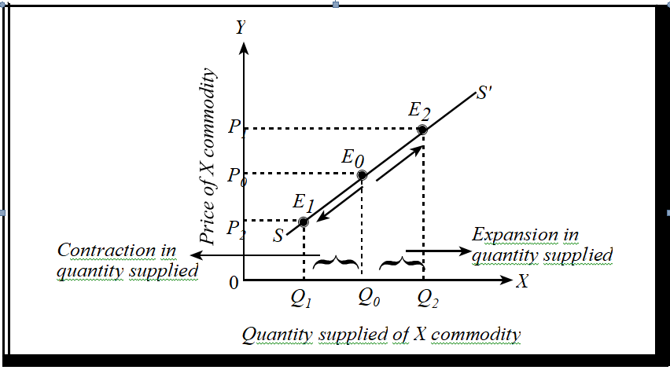
Movement along a Supply Curve
Expansion and contraction in supply

Slide 48
Shift in Supply Curve
A shift in the entire supply curve of a commodity refers to the change in supply (i.e. decrease or increase in supply) as a result of change in other factors (one or more) keeping price of the commodity constant. For example, when prices of inputs such as labour and raw materials used for the production of a commodity decrease, it will lead to decline in cost of production which will induce the producers to produce more and make available greater quantity of the commodity in the market than before at each price. As a result the entire supply curves shift to the right from S₀S₀ to S₂S₂ and alternatively, when prices of inputs used for the production of a commodity increases it leads to increase in cost of production which reduces production and supply in the market. As a result of decrease in supply, the supply curve shifts to the left from S₀S₀ to S₁S₁ as shown in the figure. It means lower quantity is supplied in the market than before as supply curve shift towards left.

Slide 49
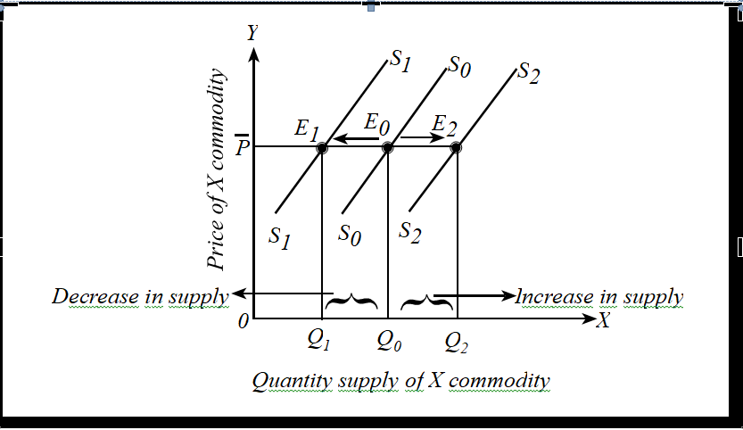
Shift in Supply Curve
Decrease or Increase in Supply

Slide 50
Determinants/Factors Causing the Shift in Supply Curve
Other things remaining the same quantity supply of a commodity is a positive function of its price.
In general supply function can be written as:
Q^{s}_{x} = f (P_{x})........................................(i) f'>0
Multivariable or true supply function can be written as:
Q^{s}_{x} = f (P_{x}, P₀, P_{I,} T, O_{f}, E, T_{S}, W…) ......................................(i)
Where,
Prices of other products (P₀)
Prices of inputs (P_{I}): PI decrease–Cost decrease- more production- increase in supply- SS curve shift towards right
State of production technology (T)
Objective of the firm (O_{f} ): profit maximize or sales maximize
Future price expectations (E):
Taxes and subsidies (T_{S})
Weather or Season (w)

Slide 51
Equilibrium Position: Interaction between Demand & Supply
The term equilibrium means the state of rest. it refers balance in opposite forces.
In the context of market analysis, equilibrium refers to a state of market in which quantity demanded of a commodity demanded of a commodity equals to the quantity supplied of the commodity.
The interaction between demand and supply determines the equilibrium price as well as quantity of any goods and services in the market.
At the equilibrium price, the quantity of the goods that buyers are willing and able to buy exactly balances the quantity that sellers are willing and able to sell. The equilibrium price is sometimes called the market-clearing price.
Before Marshall there were two views about the equilibrium: Classical (cost of production or Supply side) and Austrian school of thought (Marginal utility of the commodity or Demand side)
According to Marshall “As both blades of a scissors are important to cut a piece of cloth, so is demand and supply essential for the determination of price.”

Slide 52
Interaction between Demand & Supply
.
.
Prices (Rs. per unit) | Quantity demanded (units) | Quantity Supplied (units) | Surplus(+) Shortage (-) | Pressure on price | Result
5 | 10 | 50 | +40 | Falling | S>D
4 | 20 | 40 | +20 | Falling | S>D
3 | 30 | 30 | Market Clears | = Neutral | D=S
2 | 40 | 20 | -20 | Rising | D>S
1 | 50 | 10 | -40 | Rising | D>S

Slide 53
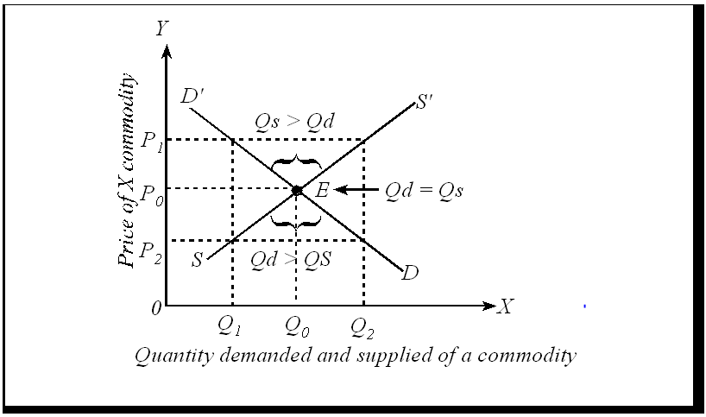
The Interplay of Demand & Supply
.

Slide 54
Equilibrium P & Q
Given,
Qd= 100 – 5p………..(i)
Qs= 10 + 40p…………(ii)
We know for equilm in the market:
Qd=Qs
100-5p= 10+40p
Solving for P
P=90/45= Rs. 2
Now substituting the value of P in equn i or ii
Qd= 100-5(2)
Or, Qd= 90=Qs
P=rs. 2 & Q= 90 units.

Slide 55
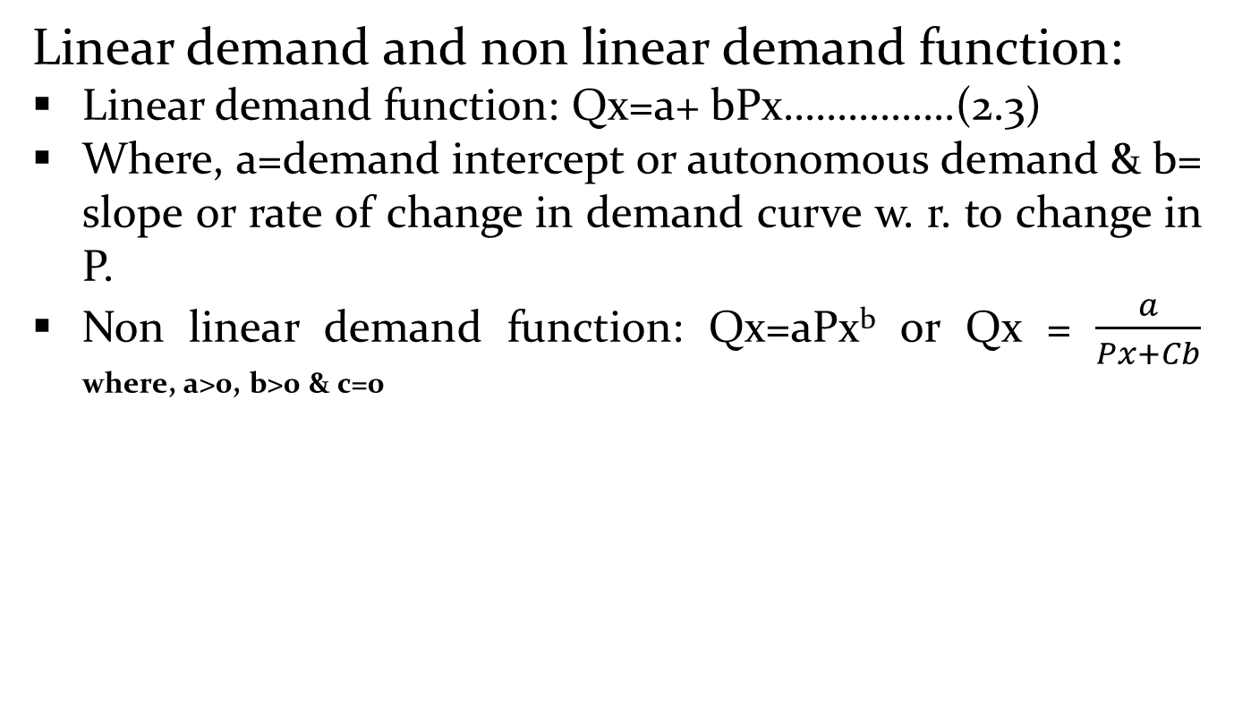
Equilibrium P & Q
Linear demand and non linear demand function:
Linear demand function: Qx=a+ bPx…………….(2.3)
Where, a=demand intercept or autonomous demand & b= slope or rate of change in demand curve w. r. to change in P.
Non linear demand function: Qx=aPx^{b} or Qx = $\frac{a}{Px+Cb}$ where, a>0, b>0 & c=0

Slide 56
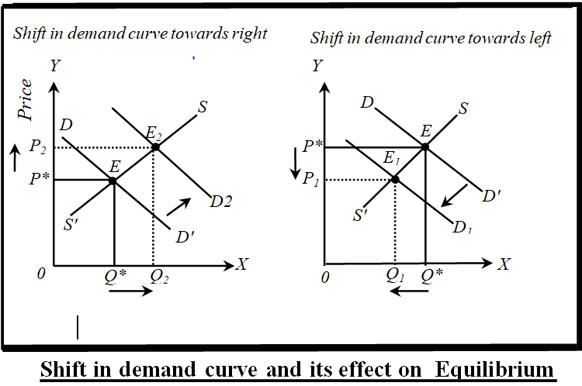
Change in Market Equilibrium
A. Change in DD curve Given SS curve
Given Supply curve if demand curve shift towards out or right: Increase in Px and Qx
Given Supply curve if demand curve shift towards origin or left: Decrease in Px and Qx

Slide 57
Change in Market Equilibrium
Given Supply curve if demand curve shift towards out or right: Increase in Px and Qx
Given Supply curve if demand curve shift towards origin or left: Decrease in Px and Qx
Q^{d}_{x} = f (P_{x}, P_{S,} Pc, Y_{c}, t, D, P_{e}, T_{p}, A, W…)
If Δyc= Y2-Y1 ……. Y increase- Qd increase it leads shift in demand curve towards right.
Alternatively if Y decrease- decrease in y- decrease in Qd- left or origin.
Causes of right ward shift in demand curve | Causes of leftward shift in demand curve
1. | 2.

Slide 58
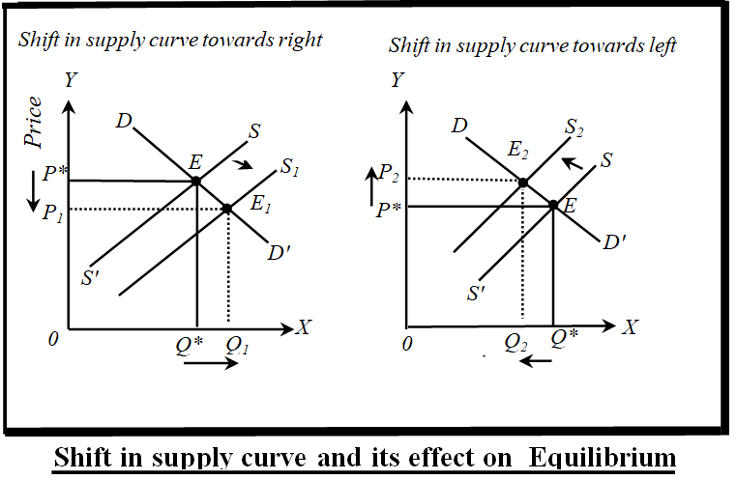
Change in Market Equilibrium
B. A. Change in SS curve Given DDcurve
Given demand curve if supply curve shift towards out or right: Decrease in Px and increase Qx
Given demand curve if supply curve shift towards origin or left: Increase in Px and decrease in Qx

Slide 59
Change in Market Equilibrium
C. Simultaneous Change in both DD curve & SS curve
(i) Simultaneous shift in both demand curve and supply curve towards out or right: Px will remain constant and increase Qx
(ii)Simultaneous shift in both demand curve and supply curve towards origin or left : Px will remain constant and decrease in Qx

Slide 60
Factors shifting the demand and Supply Curve
change in market equilibrium due to factors shifting the demand and supply curves; price, income and cross-price elasticity of demand and their measurement by percentage and arc/mid-point methods; price elasticity of supply; concept of consumer and producer surpluses; government intervention in the market through price floor ,price ceiling and tax and effect

Slide 61
Elasticity of demand
Law of demand- Dx=f(Px)….f'<0
Tendency or direction of change in Qd when change in Px.
But it does not measure the extent of change. What % change in Px leads what% change in Qd?
1.ΔDx=f(ΔPx)…keeping other factor constant. Price elasticity of demand.
2.ΔDx=f(ΔYc)…keeping other factor constant. Inceme elasticity of demand.
3. ΔDx=f(ΔPy)…keeping other factor constant. Cross price elasticity of demand.

Slide 62
Elasticity of Demand
The term elasticity refers to change in dependent variable due to any percentage change in independent variable. The law of demand explains the inverse relationship between price and quantity demanded. According to this law when the price of good falls, its quantity demanded rises and when the price rises, its quantity demanded falls. This law indicates only direction of change in quantity demanded in response to a change in price but it does not tell us by how much or to what extent the quantity demanded of a good will change in response to a change either in its price or in other determinants. This information as to how much or to what extent the quantity demanded of a good will change as a result of a change either in its price or in other determinants is provided by the concept of elasticity of demand.
Thus, elasticity of demand measures the extent or amount of change in quantity demanded of a commodity due to change in price or other determinants of a given commodity.

Slide 63
Kinds of Elasticity of Demand
1. Price elasticity of demand
2. Income elasticity of demand and
3.. Cross elasticity of demand.
Price Elasticity of Demand
Price elasticity of demand expresses the degree of responsiveness of quantity demanded of a commodity to a change in its price, given other factors such as consumer’s income, his tastes and prices of all other goods. According to K. E. Boulding “The elasticity of demand may be defined as the percentage change in quantity demanded which would result from the one percentage change in price.” Precisely, price elasticity of demand is defined as the ratio of percentage change in quantity demanded to a percentage change in price. The coefficient of price elasticity of demand is denoted by Ep and its value varies from minus infinity to zero. Since price and quantity are inversely related (with a few exceptions) price elasticity is negative. But for the sake of convenience, we ignore the minus sign and consider only the numerical value of the elasticity.

Slide 64
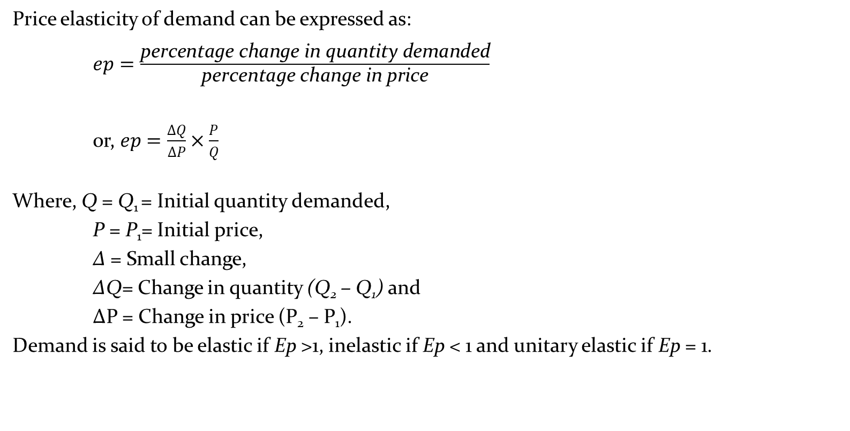
Price Elasticity of Demand
Price elasticity of demand can be expressed as:
$ep=\frac{\text{percentage} \text{change} \text{in} \text{quantity} \text{demanded}}{\text{percentage} \text{change} \text{in} \text{price}}$
0r, $ep=\frac{∆Q}{∆P}×\frac{P}{Q}$
Where, Q = Q₁ = Initial quantity demanded,
P = P₁= Initial price,
∆ = Small change,
∆Q= Change in quantity (Q₂ – Q₁) and
∆P = Change in price (P₂ – P₁).
Demand is said to be elastic if Ep >1, inelastic if Ep < 1 and unitary elastic if Ep = 1.

Slide 65

Price Elasticity of Demand
Numerical example:
If the quantity demand of a commodity increases from 1000 units to 1500 units when its per unit price decreases from Rs. 150 to Rs.100. Find price elasticity of demand.
Solution:
We know,
Price elasticity of demand ( Ep) =
Here, Q₁ = 1000 units Q₂= 1500 units
P₁= Rs. 150 P₂ = Rs. 100
Since, ∆Q = 1500 – 1000 = 500
∆P = 100-150 = -50
Then, Ep = = -1.5 % or ep>1 or elastic/relatively elastic.
The coefficient of price elasticity of demand (-1.5%) shows that any 1% decrease in price leads to 1.5% increase in quantity demanded for a commodity.
$ep=\frac{ΔQ }{ΔP}$×$\frac{P}{Q}$

Slide 66


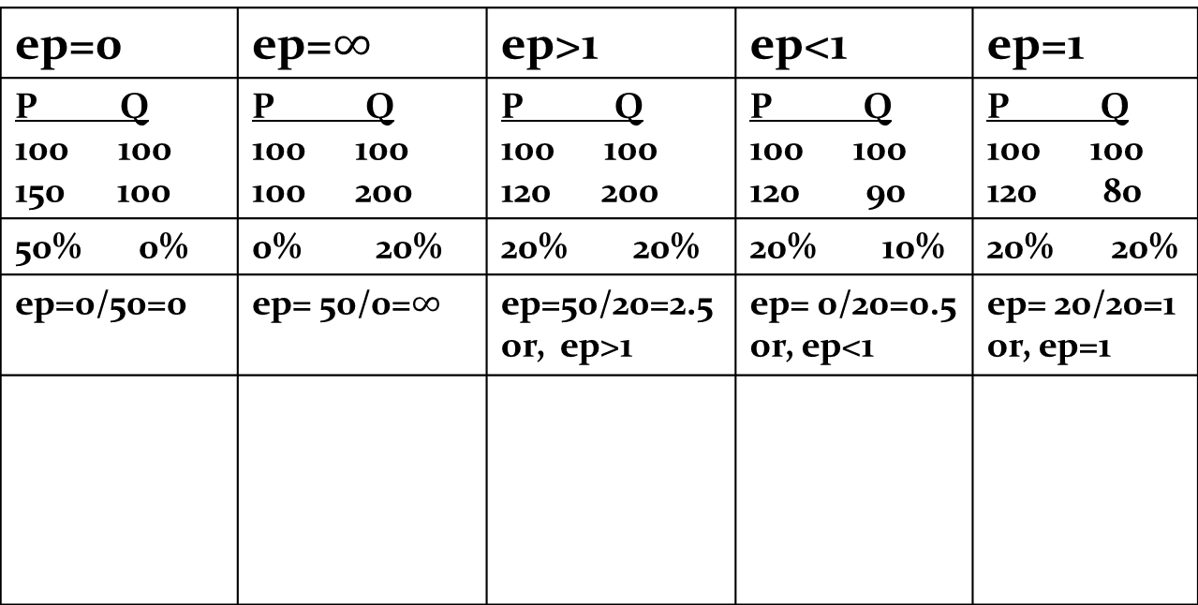
Summary of Degrees or Types of Price Elasticity of Demand
$$ep=\frac{\text{\%} \text{change} \text{in} \text{demand}}{\text{\%} \text{change} \text{in} \text{price}}$$
ep=0 | ep=$∞$ | ep>1 | ep<1 | ep=1
P Q 100 100 100 | P Q 100 100 100 200 | P Q 100 100 120 200 | P Q 100 100 120 90 | P Q 100 100 120 80
50% 0% | 0% 20% | 20% 20% | 20% 10% | 20% 20%
ep=0/50=0 | ep= 50/0=$∞$ | ep=50/20=2.5 or, ep>1 | ep= 0/20=0.5 or, ep<1 | ep= 20/20=1 or, ep=1
Px
P
0
$$\overline{Q}$$
Qx

Slide 67
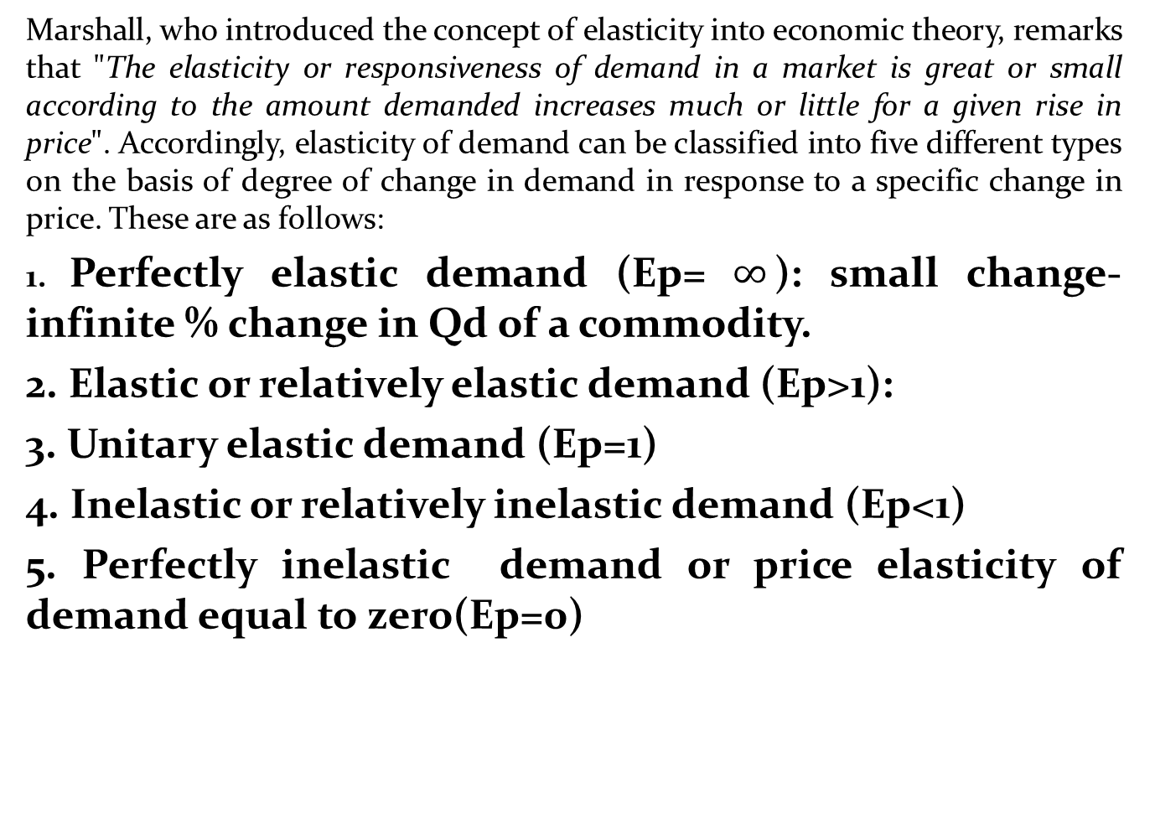
Degree or Types of Price Elasticity of Demand
Marshall, who introduced the concept of elasticity into economic theory, remarks that "The elasticity or responsiveness of demand in a market is great or small according to the amount demanded increases much or little for a given rise in price". Accordingly, elasticity of demand can be classified into five different types on the basis of degree of change in demand in response to a specific change in price. These are as follows:
1. Perfectly elastic demand (Ep= $∞$): small change-infinite % change in Qd of a commodity.
2. Elastic or relatively elastic demand (Ep>1):
3. Unitary elastic demand (Ep=1)
4. Inelastic or relatively inelastic demand (Ep<1)
5. Perfectly inelastic demand or price elasticity of demand equal to zero(Ep=0)

Slide 68
Measurement of Price Elasticity
Price elasticity of demand can be measured by three methods. They are:
1. Point method
2. Arc method and
3. Total outlay or expenditure method.

Slide 69
Model Questions: Long answer questions
What is market economy? Describe features of market economy.
Distinguish between desire and demand. why does the quantity demanded of a given commodity increases as its price falls?
(Define supply and supply schedule. What are the factors which bring about changes in supply?
What is law of demand? Explain its exceptions?
What is market demand? Explain how a market demand curve is derived.
Explain the law of demand with diagram. What are the causes of rightward shit in demand curve?
Explain the law of supply with diagram. What are the causes of shift in supply curves?
Describe the main determinants of demand. Give an example of a joint demand?
Define demand. explain the law of demand.
What is shift in demand curve? what are its causes?
What is shift in supply curve? What are the causes of rightward shift in supply curve?
Define the law of supply. Explain the law of supply with the help of table and diagram.

Slide 70
Model Questions: Short answer questions
Explain law of demand
Individual demand and market demand
Explain the law of supply
Explain the exceptions of law of demand
Distinguish between movement and shift in demand curve
Distinguish between movement and shift in supply curve
Explain the equilibrium condition with the help of demand and supply curve.
What is market economy
Discuss the cause of shift in supply curve.

Slide 71
Model Questions: Very Short answer questions
1, Why does the quantity demanded of a commodity increases as its price falls?
2. Distinguish between desire and demand
3. Define individual demand schedule
4. Define single producer’s supply curve
5. Law of demand
6.Define law of supply
7. What is market demand curve?
8. What is shift in demand curve?

